Slide 1
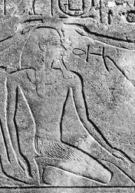
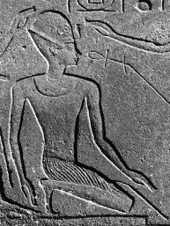
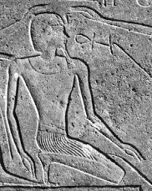
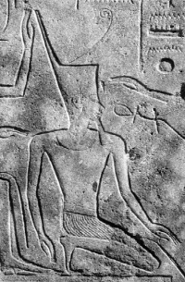
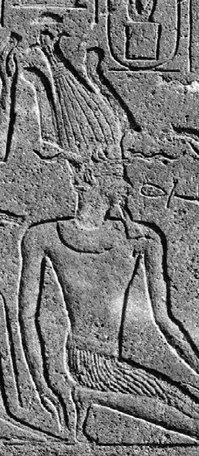
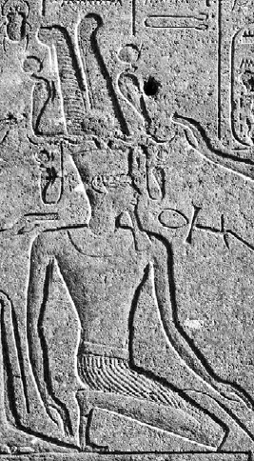
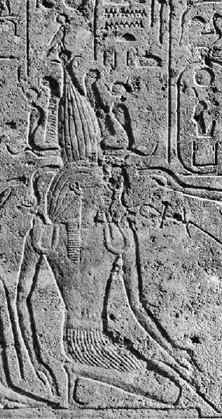
SOLAR TRANSFORMATIVE PROCESSES IN HATSHESPT’S CORONATION SCENES IN THE RED CHAPEL
Virginia Martos Armenteros
(Department of Historical and Cultural Studies, University of Toronto).

Slide 2
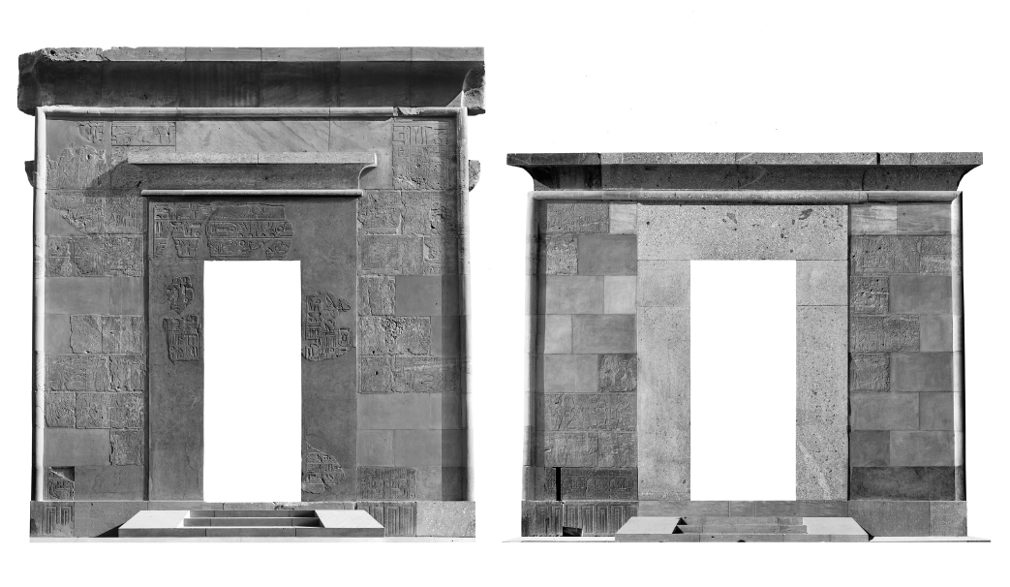
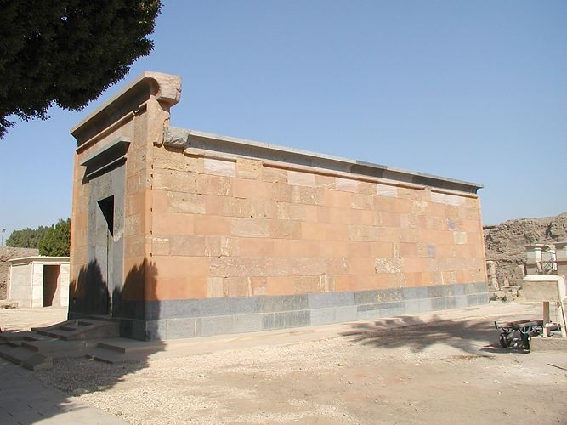
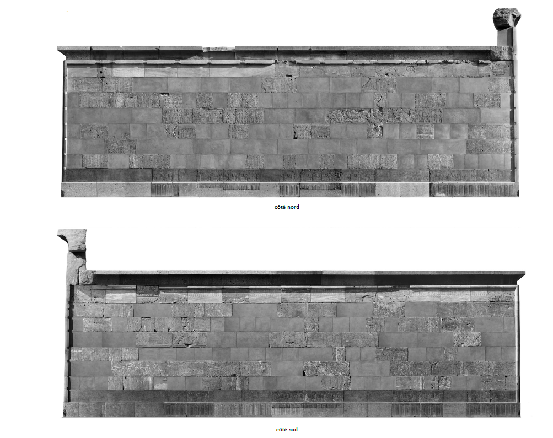
Methodology
West entrance
North Wall
Hieroglyph texts.
Iconography and symbols.
Order in which the scenes appear and the relationship that all the blocks have with each other as part of the same iconographic program.
Effects that all these elements individually and together could have had in the ancient viewer.
East entrance
South Wall
Pierre, Lacau and Henri, Chevrier. South and North Walls from the Red Chapel. 1977. Photograph. Une Chapelle d´Hatshepsout à Karnak. Paris, pl. X.
Pierre, Lacau and Henri, Chevrier. South and North Walls from the Red Chapel. 1977. Photograph. Une Chapelle d´Hatshepsout à Karnak. Paris, pl. IX.
Jon, Bodsworth. Red Chapel. 2011. Photograph, Madain Project.

Slide 3
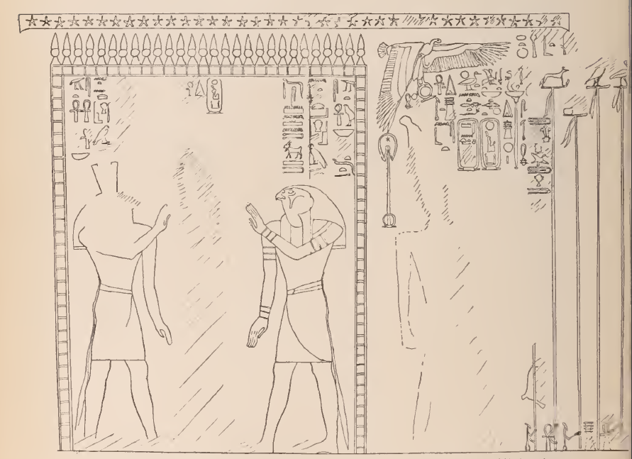
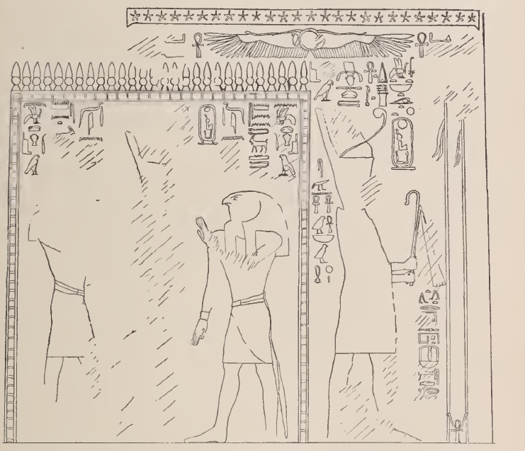
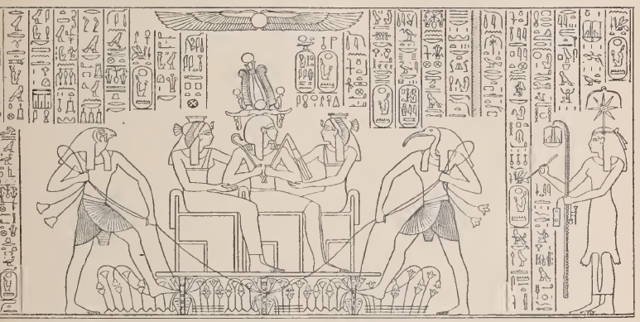
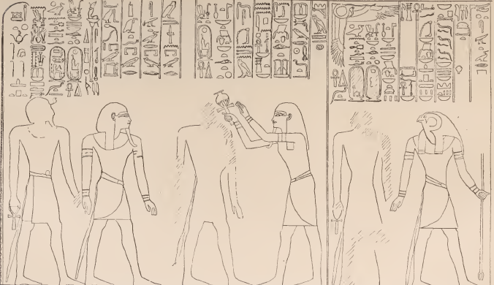
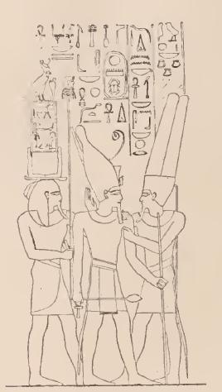
Coronation ceremony
01
03
02
Coronation
Induction
Purification and presentation
Purification by the gods Horus and Amun.
Presentation to the corporation of Gods of the North and the South and to the royal court.
Announcement of the royal titulary.
Union between the main god and the king through an embrace.
Handing of the ankh symbol by the god Amun to the new king.
Final recognition of the king.
Granting of the royalty of Upper and Lower Egypt through the corresponding symbolic crowns.
Meeting of the two regions at the king´s feet.
Royal procession outside of the temple wall.
Edouard, Naville. King Hatshepsut purified by Ha, in the pr-wr is guided by Horus to the crowning room. 1898. Drawing. The Temple of Deir el Bahari III: End of northern half and southern half, London, pl. LXIII.
Edouard, Naville. King Hatshepsut received the White and Red crowns by the gods Horus and Sit on the South and North pavilions. 1898. Drawing. The Temple of Deir el Bahari III: End of northern half and southern half, London, pl. LXIV.
Auguste, Mariette. Meeting of the two regions at king Hatshepsut´s feet. 1969. Drawing. Abydos, vol. 4. Paris, pl. 31a.
Karl R., Lepsius. King Tuthmose III embraced by the god. 1858. Drawing. Denkmäler aus Aegypten und Aethiopien, vol. III. Berlin, p. 34.

Slide 4
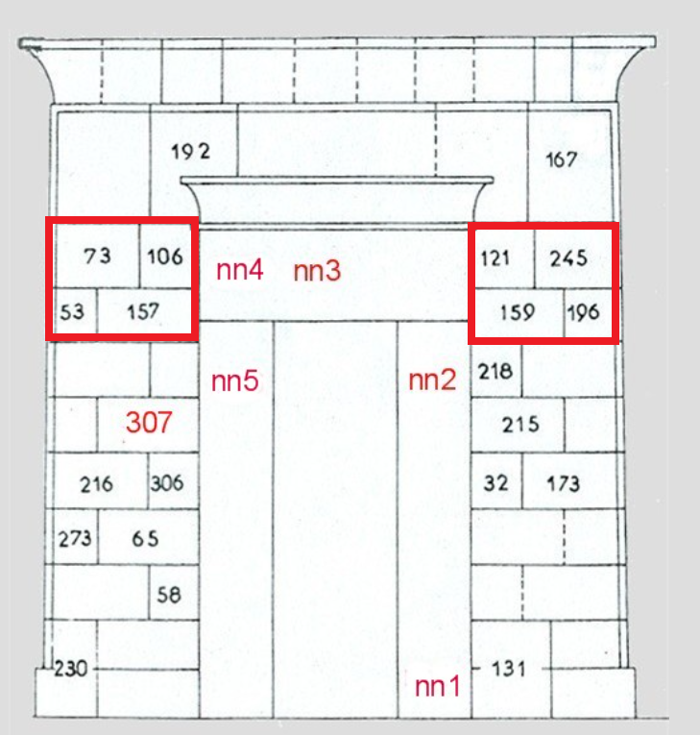
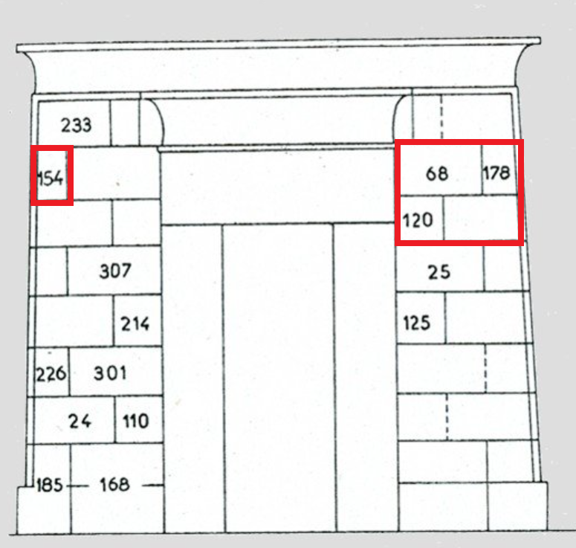
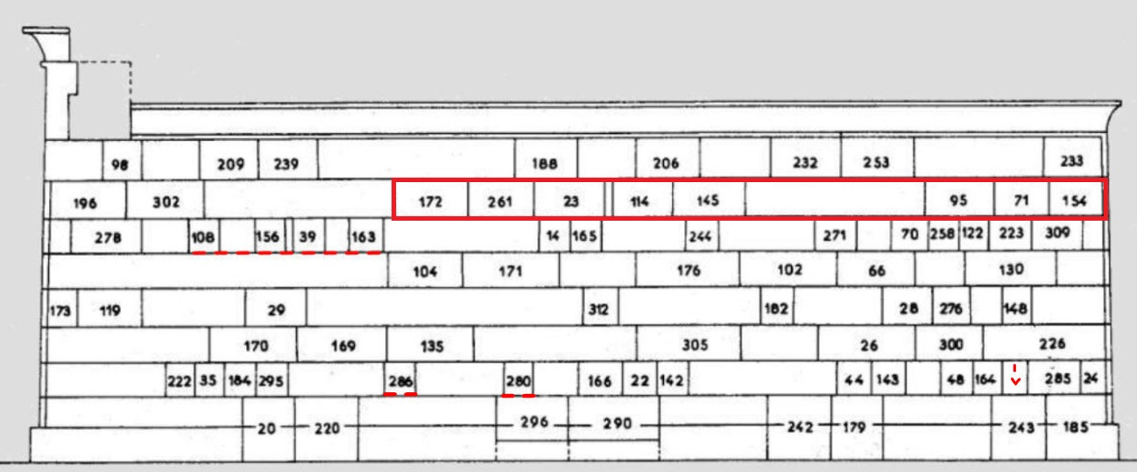
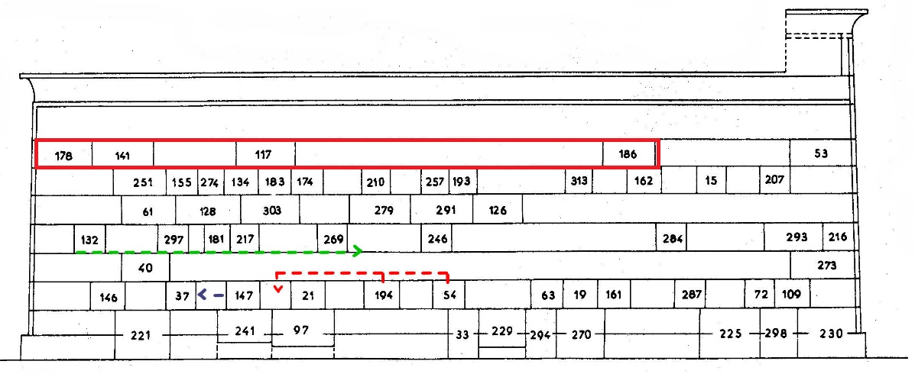
Coronation ceremony in the Red Chapel: Scheme
West
entrance
East
entrance
North Wall
South Wall
Pierre, Lacau and Henri, Chevrier. Scheme of North Wall. 1979. Drawing. Une Chapelle d´ Hatshepsout à Karnak. Cairo, pl. 1.
Pierre, Lacau and Henri, Chevrier. Scheme of South Wall. 1979. Drawing. Une Chapelle d´ Hatshepsout à Karnak. Cairo, pl. 1.
Pierre, Lacau and Henri, Chevrier. Scheme of West and East entrances. 1979. Drawing. Une Chapelle d´ Hatshepsout à Karnak. Cairo, pl. 1.

Slide 5
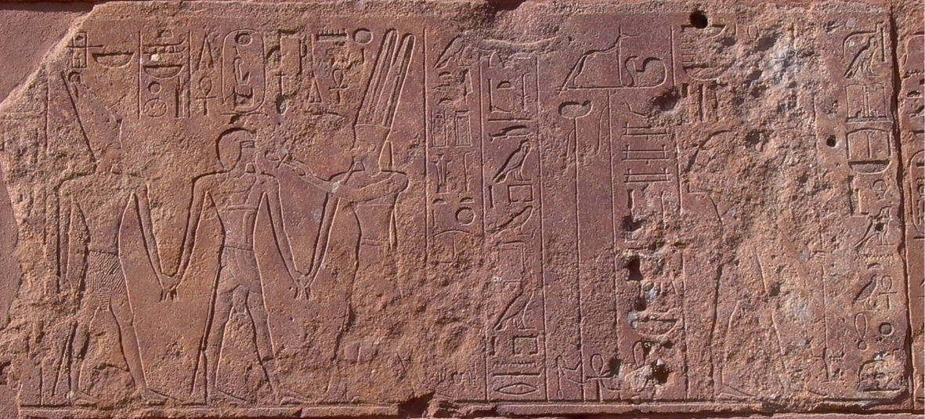
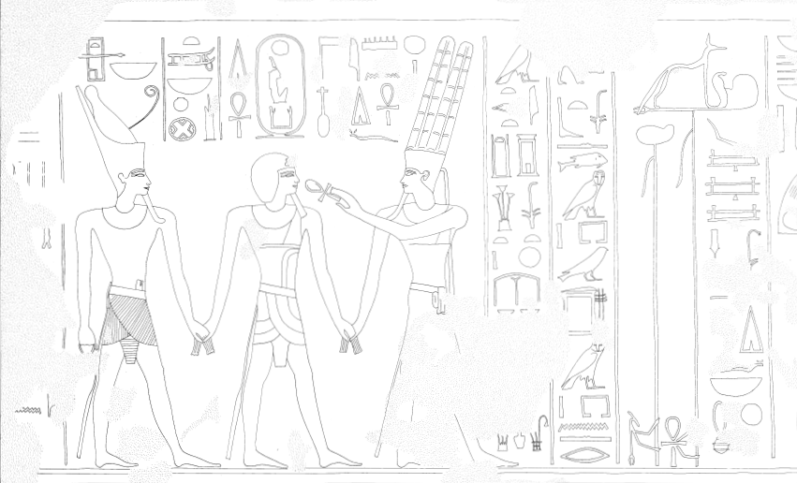
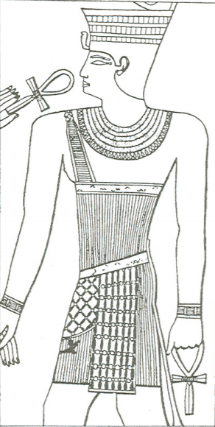
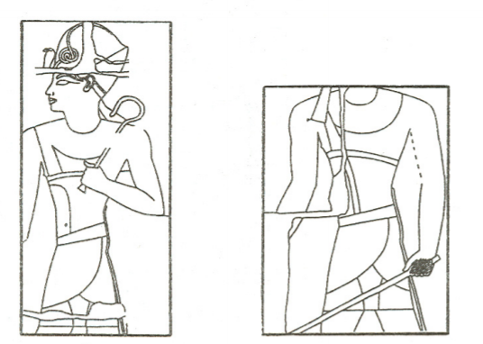
First scene (South Wall, Block 172)
Image 1: Wallis, Budge and Tomasz, Podgórski. Reproduction of King Narmer smiting his foe; King Senuseret I wearing a triumphal dress in his jubilee kiosk in Karnak. 2019. Drawing. From Fetish to God in Ancient Egypt and Some remarks on the evolution of royal triumphal dress. London, pp. 28/32.
Image 2: Götzburg. King Amenhotep III wears the Horus dress in the bs n nsw scene and in the Hwt bHsw scene. 1993. Drawing. Zur Semantik. Berlin, p. 39.
Pierre, Lacau and Henri, Chevrier. Scheme of South Wall. 1979. Drawing. Une Chapelle d´ Hatshepsout à Karnak. Cairo, pl. 1.
Image 1: Karl H., Leser. South Wall – Block no. 172. 2014. Photograph. Maat-ka-ra. Cairo.
Image 2: Pierre, Lacau and Henri, Chevrier. South Eall Block 172. 1979. Photograph and drawing. Une Chapelle d´ Hatshepsout à Karnak. Cairo, p. 78.

Slide 6
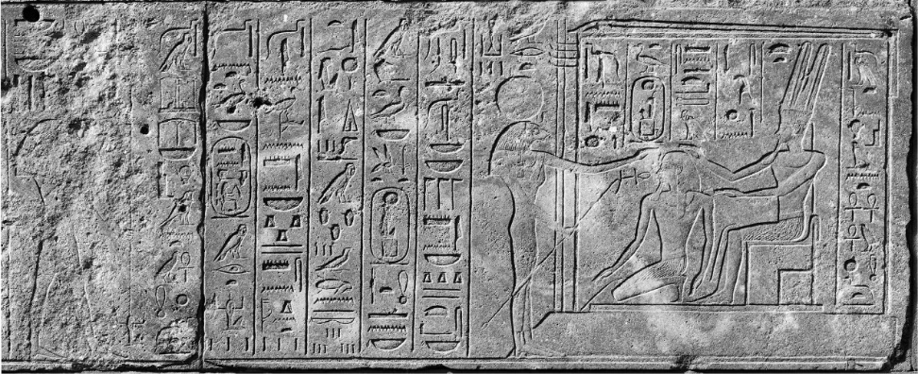
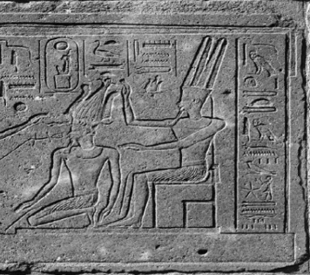
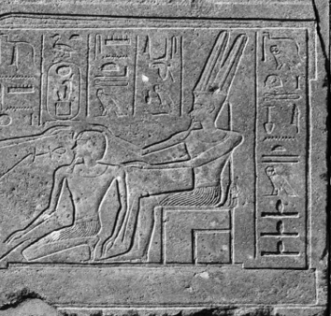
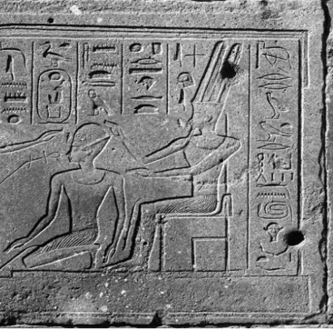
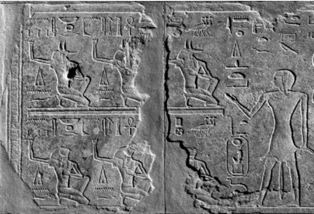
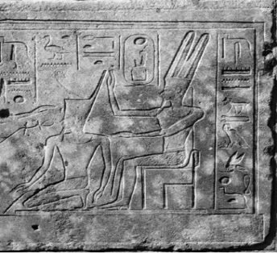
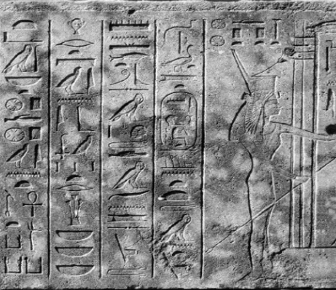
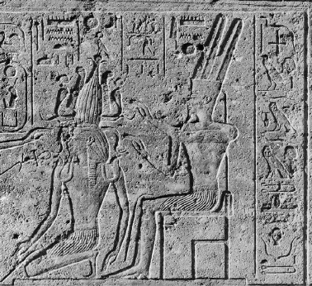
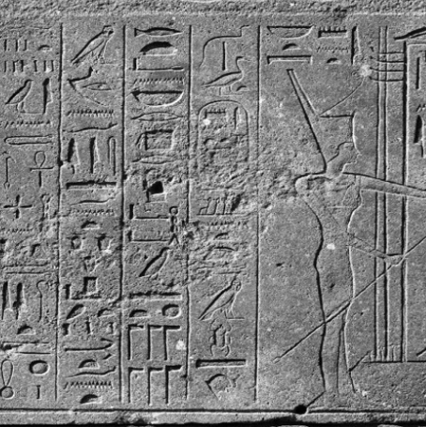
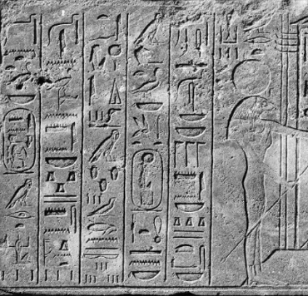
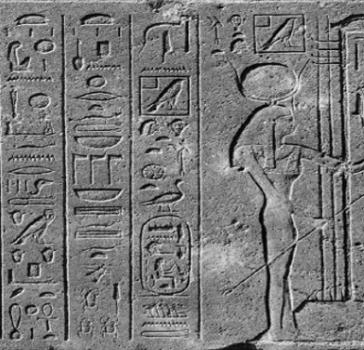
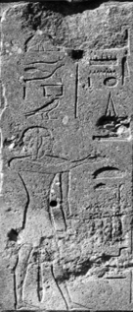
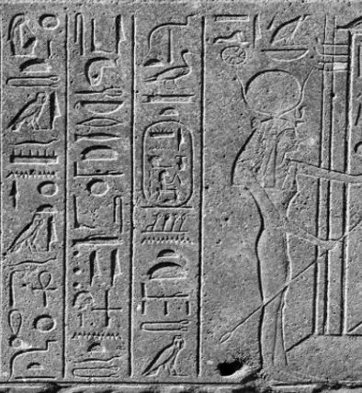
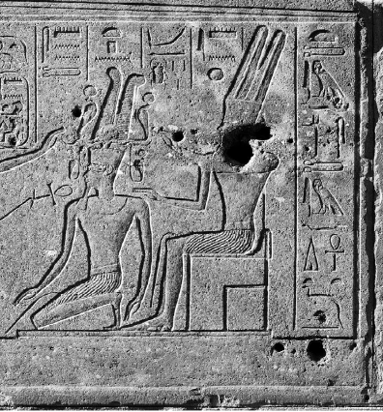
Witnessing god
Protective goddesses
Crown
Pierre, Lacau and Henri, Chevrier. Hatshepsut’s coronation program. 1979. Photographs. Une Chapelle d´ Hatshepsout à Karnak. Cairo, pp. 79-154.

Slide 7
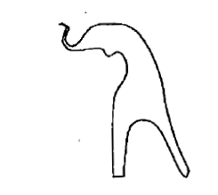
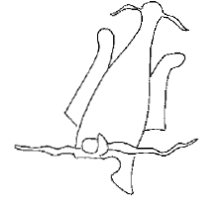
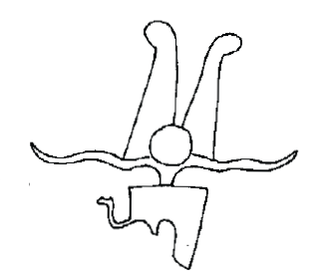
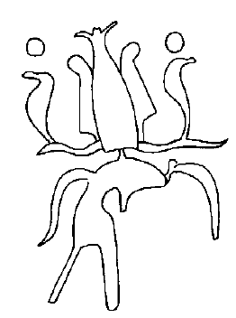
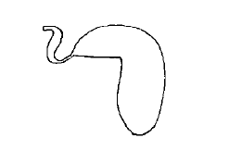
General scheme
Groups | Group I | Group II | Group III
First crown | Nemes crown | Red crown | Atef crown
Second crown | Blue crown | White crown | Henu crown
Third crown | Ibs crown | Double crown | Crown of Re
Final attributes | Recognition and support that the king of Egypt has both in the divine and terrestrial realms | Unification of Upper and Lower Egypt in the figure of the king. Rule over the two halves of the solar cycle, day and night. | Final rebirth. Climax of all the powers and attributes of the new king of Egypt.
South Wall
Purification
Purification
Nemes Crown
Group I: Nemes, Blue and Ibs Crowns
Purification
Blue Crown
Ibs Crown
Investment of crowns
Group II: Red, White and Double Crowns
Red Crown
Atef Crown
Group III: Atef and Henu Crowns and Crown of Re
Henu Crown
Crown of Re
Pierre, Lacau and Henri, Chevrier. Scheme of South Wall. 1979. Photograhs. Une Chapelle d´ Hatshepsout à Karnak. Cairo, pl. I

Slide 8
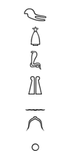
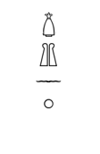
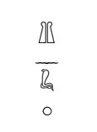
Iconographic sentences
A pair of ram´s horns mark a dividing line similar to the horizon. The lower part, where the small uraei are, symbolizes the faint light that is visible when the dawn is approaching but without the solar disk being fully visible. Meanwhile, the upper part, where the large uraei are, refers to the bright light resulting from dawn. Finally, the two ostrich feathers reflect the bright light from the two eyes of the sun god.
The canonical base reinforces the idea of ​​creation and the primeval mountain; the horns as a dividing element, that is, the horizon; and the feathers of the ostrich as the two eyes of the solar god. Consequently, the Atef Crown could be viewed as the early crown of dawn.
The horns mark a division: the lower part, formed by the Nemes crown together with the two smaller uraei, refers to the moment just before the dawn, while the upper part, with the bigger uraei and the solar disks, represents the dawn itself. The upper part is formed by the Atef crown, but this time it is complemented by two large uraei crowned by two solar discs and two ostrich feathers. The upper part of the horns reflects the fullness of the solar rebirth.

Slide 9
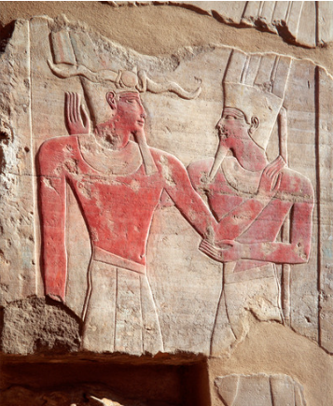
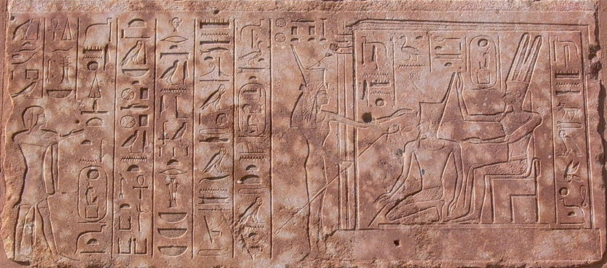
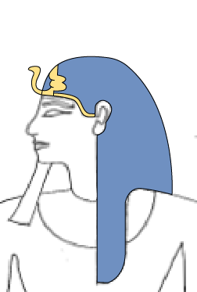
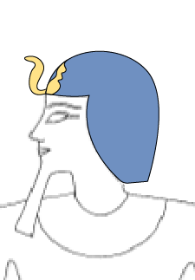
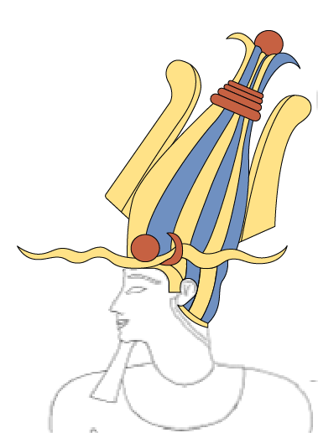
Color patterns
Ivan, Vdovin. Relief of the Red Chapel of Hatshepsut. 2007. Photograph.
Nemes crown
Blue crown
Ibs crown
Red crown
Atef crown
Henu crown
Crown of Re
Pierre, Lacau and Henri, Chevrier. Hatshepsut’s coronation program. 1979. Drawings. Une Chapelle d´ Hatshepsout à Karnak. Cairo, pp. 79-154.
Karl H., Leser. South Wall – Block no. 145. 2014. Photograph. Maat-ka-ra. Cairo.

Slide 10
Conclusions and bibliography
Burgos, Frank, Larché, François. La Chapelle Rouge. Le sanctuaire de barque d´Hatshepsout. Vol I and II. Paris: CulturesFrance, 2006-2008.
Collier, S.A. “The Crowns of Pharaoh: Their Development and Significance in Ancient Egyptian Kingship”. Ph.D. diss. (University of California Los Angeles, 1996).
Goebs, Katja. “Crowns Egyptian”. In The Encyclopedia of Ancient History, edited by Roger S. Bagnall, Kai Brodersen, Craige B. Champion, Andrew Erskine, and Sabine R. Huebner. London: Blackwell, 2013.
Goebs, Katja. “Receive the Henu – that you may shine forth in it like Akhty. Feathers, Horns and the Cosmic Symbolism of Egyptian Composite Crowns”. In Royal versus Divine Authority. Acquisition, legitimization, and renewal of power, edited by Filip Coppens, Jirí Janák, and Hana Vymazalová. Prague: 2013.
Goebs, Katja. “King as God and God as King. Colour, Light and Transformation in Egyptian Ritual”. In Palace and Temple. Architecture, Decoration, and Ritual, edited by Rolf Gundlach and Kate Spence. Wiesbaden: 2011.
Lacau, P., Chévrier, H. Une Chapelle d´Hatshepsout à Karnak I. Cairo : L´Institut Français d´Archéologie Orientale Du Caire, 1977-79.
Moret, A. Du caractère Religieux de la Royauté Pharaonique. Paris : Ernest Leroux, 1902.
Naville, E. The temple of Deir El Bahari (Band 3): End of the northern half and southern half of the middle platform. London: Egypt Exploration Fund, 1898.
Podgórski, T. “Some remarks on the evolution of royal triumphal dress”. Prace Archeologiczne, Vol. 51 (1992).
Is Hatshepsut’s coronation program in the Red Chapel unique?
Can this interpretation be also seen in other iconographic programs or texts?
Does the rest of the representations in the Red Chapel follow a similar topic?
What is next?
Study other iconographic programs and textual evidence about the Ancient Egyptian coronation ceremony.
Compare Hatshepsut’s iconographic program to the ones of the other kings and queens.
Thank you for your attention
Do you have any Questions?
virginia.martosarmenteros@utoronto.mail.ca

